Slide 1
Woodlands CS Club
Graph Theory
Group A
12/14/2020

Slide 2
Agenda
Introduction to Graph Theory
What are graphs?
Graph terminology
Graph Representation
Graph Traversal
Introduction
Types of graph traversal
Review of Depth First Search
Breadth First Search
Breadth First Search practice
Conclusion

Slide 3
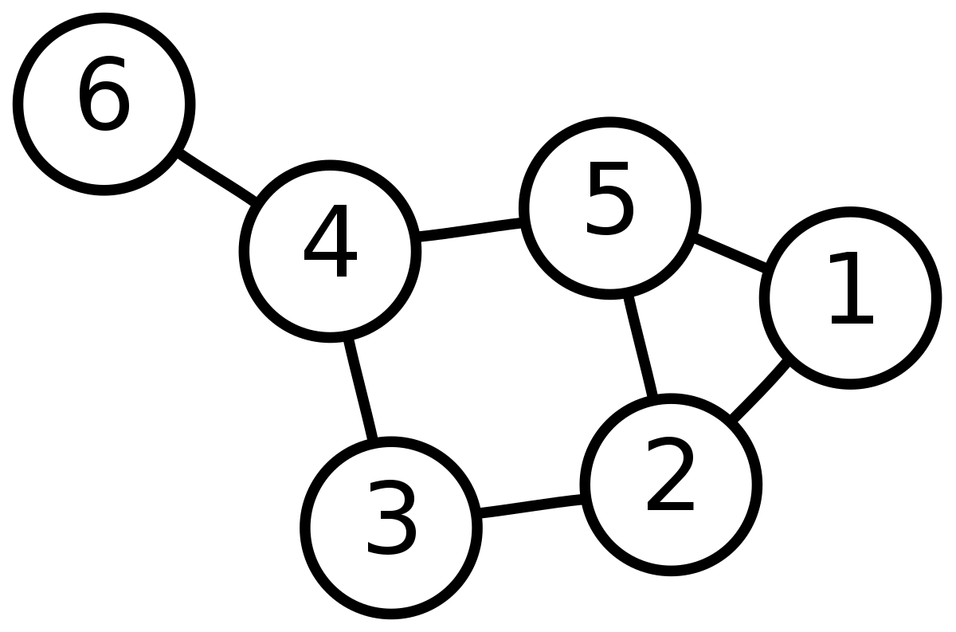
What Are Graphs?
Graph theory is the study of graphs, which are mathematical structures used to model pairwise relations between objects.
Unlike the graphs you may be used to, these graphs are made of nodes which are connected by edges.
Nodes are fundamental units and represent objects.
Edges connect nodes and show a relationship.
In the graph to the right, the numbered circles represent
nodes, and the lines show connections between these nodes.

Slide 4
General Graph Terminology
Two nodes are considered adjacent if they share an edge.
In other words, these two nodes are connected.
A path is a sequence of nodes where each node within the sequence is adjacent to its neighbours.
A path of the graph to the right would be: 6 → 4 → 5 → 1
A cycle is a path where the starting and ending node are identical.
If a graph does not contain a cycle, it is considered acyclic
A cycle of the graph to the right would be: 2 → 5 → 4 → 3 → 2
A graph is considered connected if there exists a path between every pair of vertices.

Slide 5
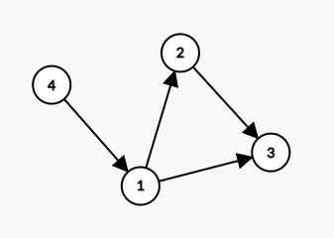
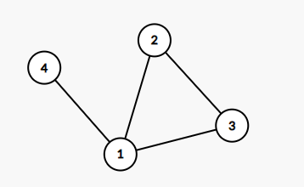
Edge Terminology
Edges in graphs can have many different properties:
Edges can either be directed or undirected:
Directed edges only allow traversal in one direction.
Graphs comprised of directed edges are known as directed graphs.
Undirected/Bidirectional edges allow for traversal in both directions
Graphs comprised of bidirectional edges are known as undirected graphs.
Directed Graph
Undirected Graph

Slide 6
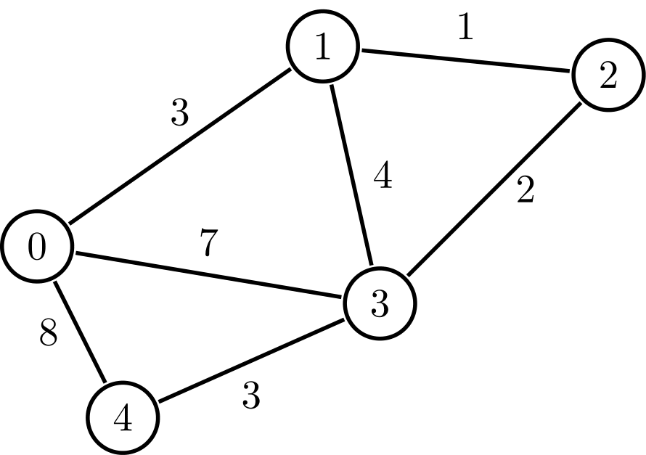
Edge Terminology Cont.
Edges in graphs can have many different properties:
Edges can also be either weighted or unweighted:
Weighted edges associate a numerical value to each edge
These numbers can represent multiple things, such as:
Length
Cost
Unweighted edges do not associate a numerical value to each edge
Different edge properties may combine with each other. For example, the image on this slide represents a weighted bidirectional graph.

Slide 7
Graph Representation
How can we represent graphs in our code?
There are three major representations:
Adjacency List
Adjacency Matrix
Edge List
The adjacency list is the most commonly used representation. For the memory complexity, we will assume that V represents the number of vertices/nodes and E represents the number of edges.

Slide 8
Graph Representation: Adjacency List
Memory Complexity: O(V+E)
Idea: We represent the graph by keeping a list for each node, where all the elements within the list represent adjacent nodes.
This can be done in code by creating an array of lists.

Slide 9
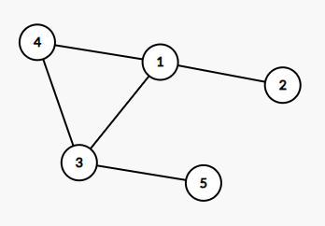
Adjacency List Example
Node | List (Connected Nodes)*
1 | 2, 3, 4
2 | 1
3 | 1, 4, 5
4 | 1, 3
5 | 3
*Note that the connected nodes may not always be in sorted order.

Slide 10
Adjacency List Code
Python
C++
graph=[[] for i in range(V+1)]
def createEdge(x, y):
# create an edge from x --> y (directed)
graph[x].append(y)
vector<int> graph[V+1];
void createEdge(int x, int y) {
// create an edge from x --> y (directed)
graph[x].push_back(y);
}
Java
ArrayList<Integer>[] graph = new ArrayList[V+1]; //Array of ArrayLists
for(int i=1; i<=V; i++){
graph[i] = new ArrayList<Integer>();
}
static void createEdge(ArrayList<Integer>[] graph, int x, int y){
// create an edge from x --> y (directed)
graph[x].add(y);
}

Slide 11
Graph Representation: Adjacency Matrix
Memory Complexity: O(V^2)
Idea: We keep a 2D boolean array where arr[i][j] will be true if there exists an edge going from nodes i and j, otherwise false.

Slide 12
Graph Representation: Edge List
Memory Complexity: O(E)
Idea: We simply keep a list which stores all the edges in the graph as pairs.
Example: {(1, 3), (1, 2), (1, 4), (4, 3), (3, 5), (3, 1), (2, 1), (4, 1), (3, 4), (5, 3)}

Slide 13
Graph Theory Application: Graph Traversal
Graph traversal allows us to search and gain information by visiting all nodes that are reachable from a source node. Graph traversal is very fundamental to graph theory in computer science.
There are many graph traversal algorithms, but for now we’ll cover two of them.
Depth First Search (Review)
Check if two nodes are connected
Breadth First Search
Also checks if two nodes are connected
Finds the shortest distance from source node to target node in an unweighted graph

Slide 14
Graph Traversal: Depth First Search
As hinted by the name, this graph traversal algorithm explores a single path from the source node until it cannot traverse further, at which point it will backtrack to an unexplored path.
This graph traversal algorithm is written recursively, and requires an external visited array which marks nodes that have already been traversed.
As stated previously, the idea is if our current node is n, we DFS all adjacent nodes if they are not yet visited.

Slide 15
Graph Traversal Visualization

Slide 16
Graph Traversal: Depth First Search Code
Python
C++
def dfs(n, graph):
global vis
vis[n] = 1
for node in graph[n]:
if(vis[node] == 0):
dfs(node,graph)
void dfs(int n){
vis[n] = 1;
for(int node : graph[n]){
if(!vis[node]) dfs(node);
}
}

Slide 17
Problem 1: https://dmoj.ca/problem/vmss7wc16c3p2

Slide 18
Solution:
Run a depth first search and then check whether house B has been visited.
A few errors that may have caused your program to WA:
Implemented DFS incorrectly
Forgot that the roads are bidirectional meaning they can be traversed in both directions
Did not account for edge case where house A = house B

Slide 19
Graph Traversal: Breadth First Search
What if we want to find the shortest path between two nodes though? Since depth first search traverses an entire path before backtracking, the distance is not always optimal.
To find the shortest path from one node to another node, we can use an algorithm known as Breadth First Search.
The idea is as follows:
We store a queue which contains nodes that we must process. We take the next node in the queue and process it by visiting all unvisited adjacent nodes. We keep a boolean array which will store the visited nodes, and we will keep a distance array which stores the distance. We terminate once we have processed all nodes.

Slide 20
Graph Traversal Visualization

Slide 21
BFS Code (C++)
deque<int> q; // queue
bool vis[V+1]; // visited array
int dist[V+1]; // distance from root node to node[i]
q.push_back(s); // assuming root node is s
vis[s] = 1; // mark as visited
dist[s] = 0; // initialize distance to 0
while(q.size()) { // while we still have nodes to process
int topNode = q.front();
q.pop_front(); // remove top node
for(int node : graph[topNode]) { // every adjacent node
if(!vis[node]) { // if it has not been visited
vis[node] = 1; // visit it
dist[node] = dist[topNode] + 1; // update distance
q.push_back(node); // insert into the queue
}
}
}

Slide 22
BFS Code (Python)
q=[] # queue
vis=[0 for i in range(V+1)] # visited array
dist=[0 for i in range(V+1)] # distance from root node to node[i]
q.append(s) # assuming root node is s
vis[s] = 1 # mark as visited
while(len(q)): # while we still have nodes to process
topNode = q.pop() # remove top node
for node in graph[topNode]: # process adjacent nodes
if not vis[node]: # if not visited yet
vis[node] = 1 # visit it
dist[node] = dist[topNode] + 1 # update distance
q.append(node) # insert into queue

Slide 23
BFS Code (Java)
LinkedList<Integer> Q = new LinkedList<Integer>(); //queue
boolean[] vis = new boolean[N+1]; //visited array
int[] dist = new int[N+1]; //dist array
vis[s] = true;
dist[s] = 0;
Q.add(s);
while(!Q.isEmpty()) {
int cur = Q.poll();
for(int node: graph[cur]) {
if(!vis[node]) {
vis[node] = true;
dist[node] = dist[cur] + 1;
Q.add(node);
}
}
}

Slide 24
Breadth First Search Applications
Shortest path between two nodes in an unweighted graph
Connectivity checking
DFS can also be used for this and the implementation is usually shorter than for BFS
There are many graph problems that be solved with breadth first search by modifying the code slightly

Slide 25
Homework/Practice Problems
CCC '18 J5 - Choose your own path: https://dmoj.ca/problem/ccc18j5
TSOC '15 Contest 1 #5 - Giant Ants: https://dmoj.ca/problem/tsoc15c1p5
Mock CCC '18 Contest 5 J5/S3 - Directed Graph Connectivity: https://dmoj.ca/problem/nccc5j5s3
DMOPC '17 Contest 1 P3 - Hitchhiking Fun: https://dmoj.ca/problem/dmopc17c1p3

